Slide 1

GLOBAL INFLATION
FROM 2002 TO 2022
Love Lorissaint
Derilee Walters
Sacide Belair
Phuong Aissa
Liseth Rubio

Slide 2

Agenda
Introduction
Descriptive statistics on different types of inflation across the world:
Energy Consumer Price Inflation
Food Consumer Price Inflation
Headline Consumer Price Inflation
Official Core Consumer Price Inflation
Producer Price Inflation
Inflation throughout COVID-19
Predictive statistics based on the country with highest inflation
Conclusion

Slide 3

Introduction
Inflation: The rise in prices over time that significantly impacts economies and individuals.
Objective: Analyze global inflation trends using data from two CSV datasets.
Tools used:
Python
Jupyter Notebook
SQL
Findings: Offer valuable insights into statistics on different types of inflation across the world and predictive statistics on the country with the highest inflation rate.

Slide 4
Which country saw the highest inflation increase during COVID-19?
A. Turkey
B. Argentina
C. Venezuela
D. Zimbabwe

Slide 5

DESCRIPTIVE STATISTICS
on Different Types of Inflation

Slide 6
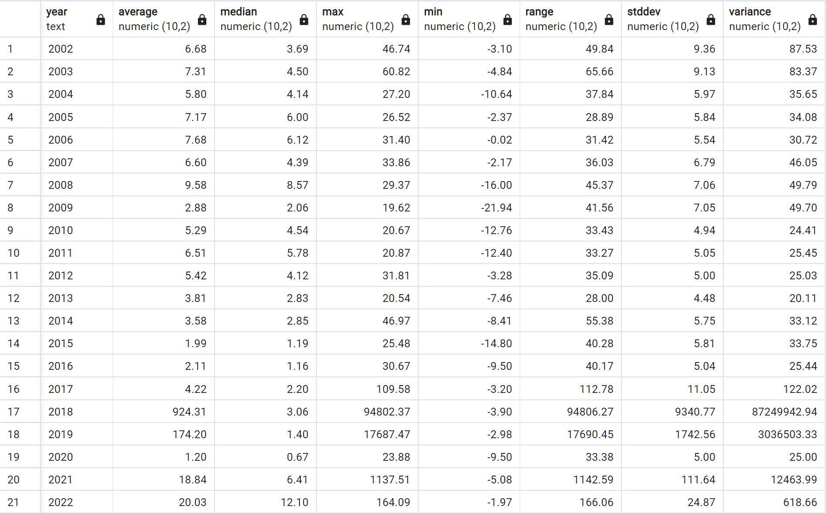
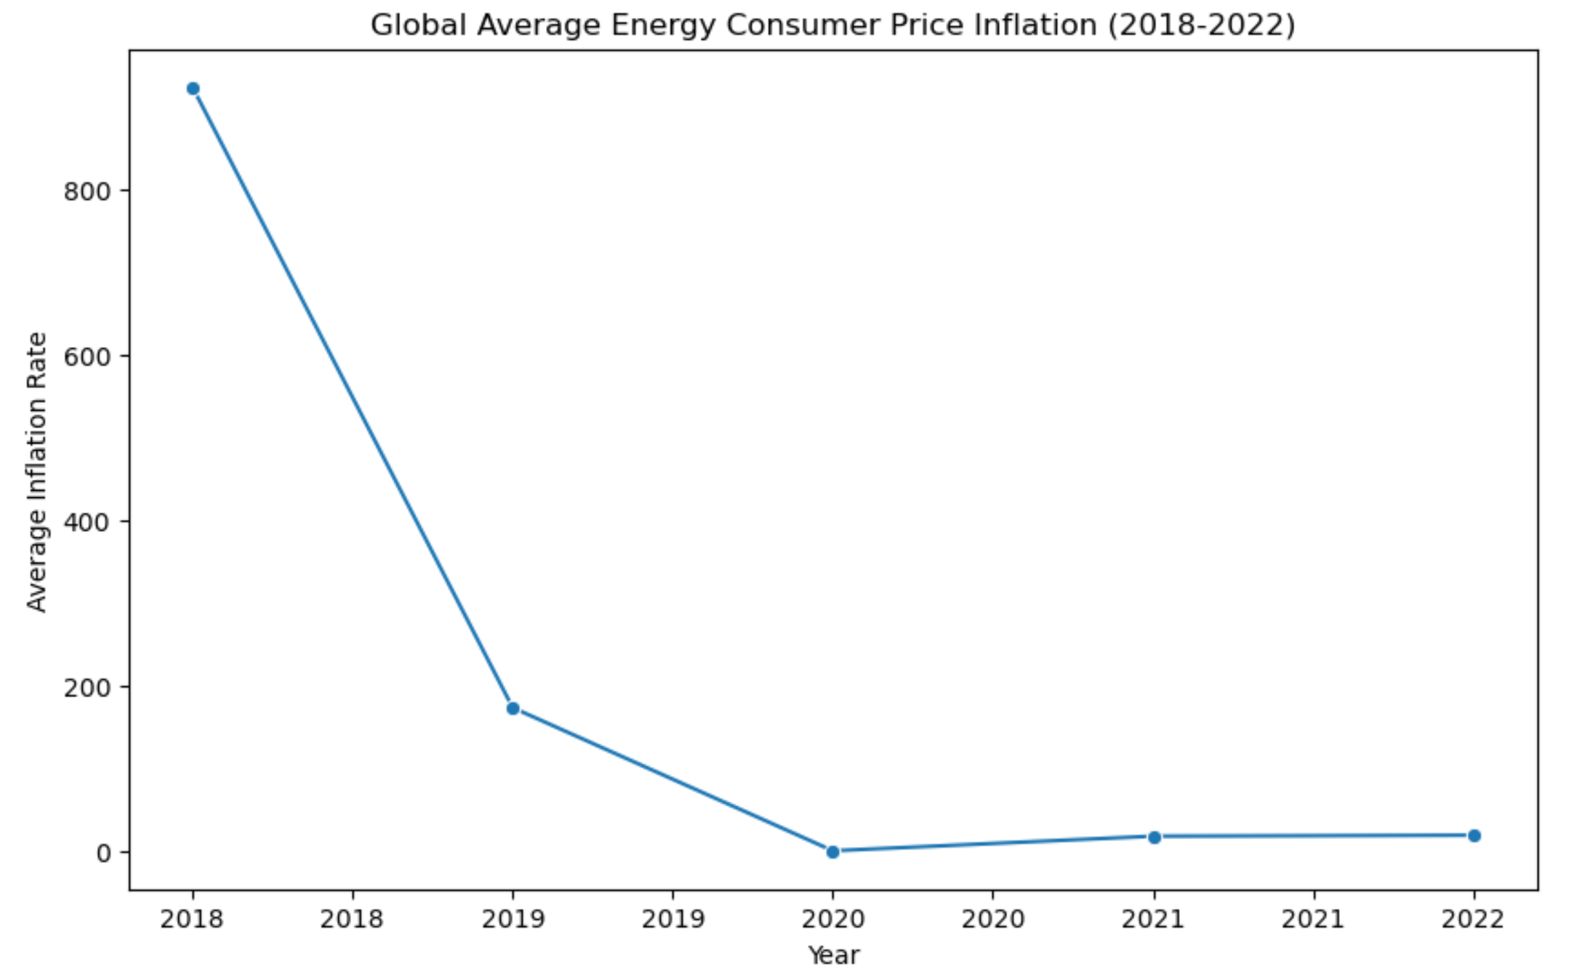
Energy Consumer Price Inflation -Inflation Rate for Energy Cost-

Slide 7
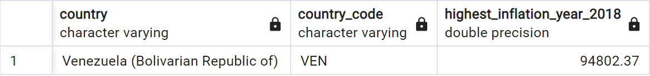
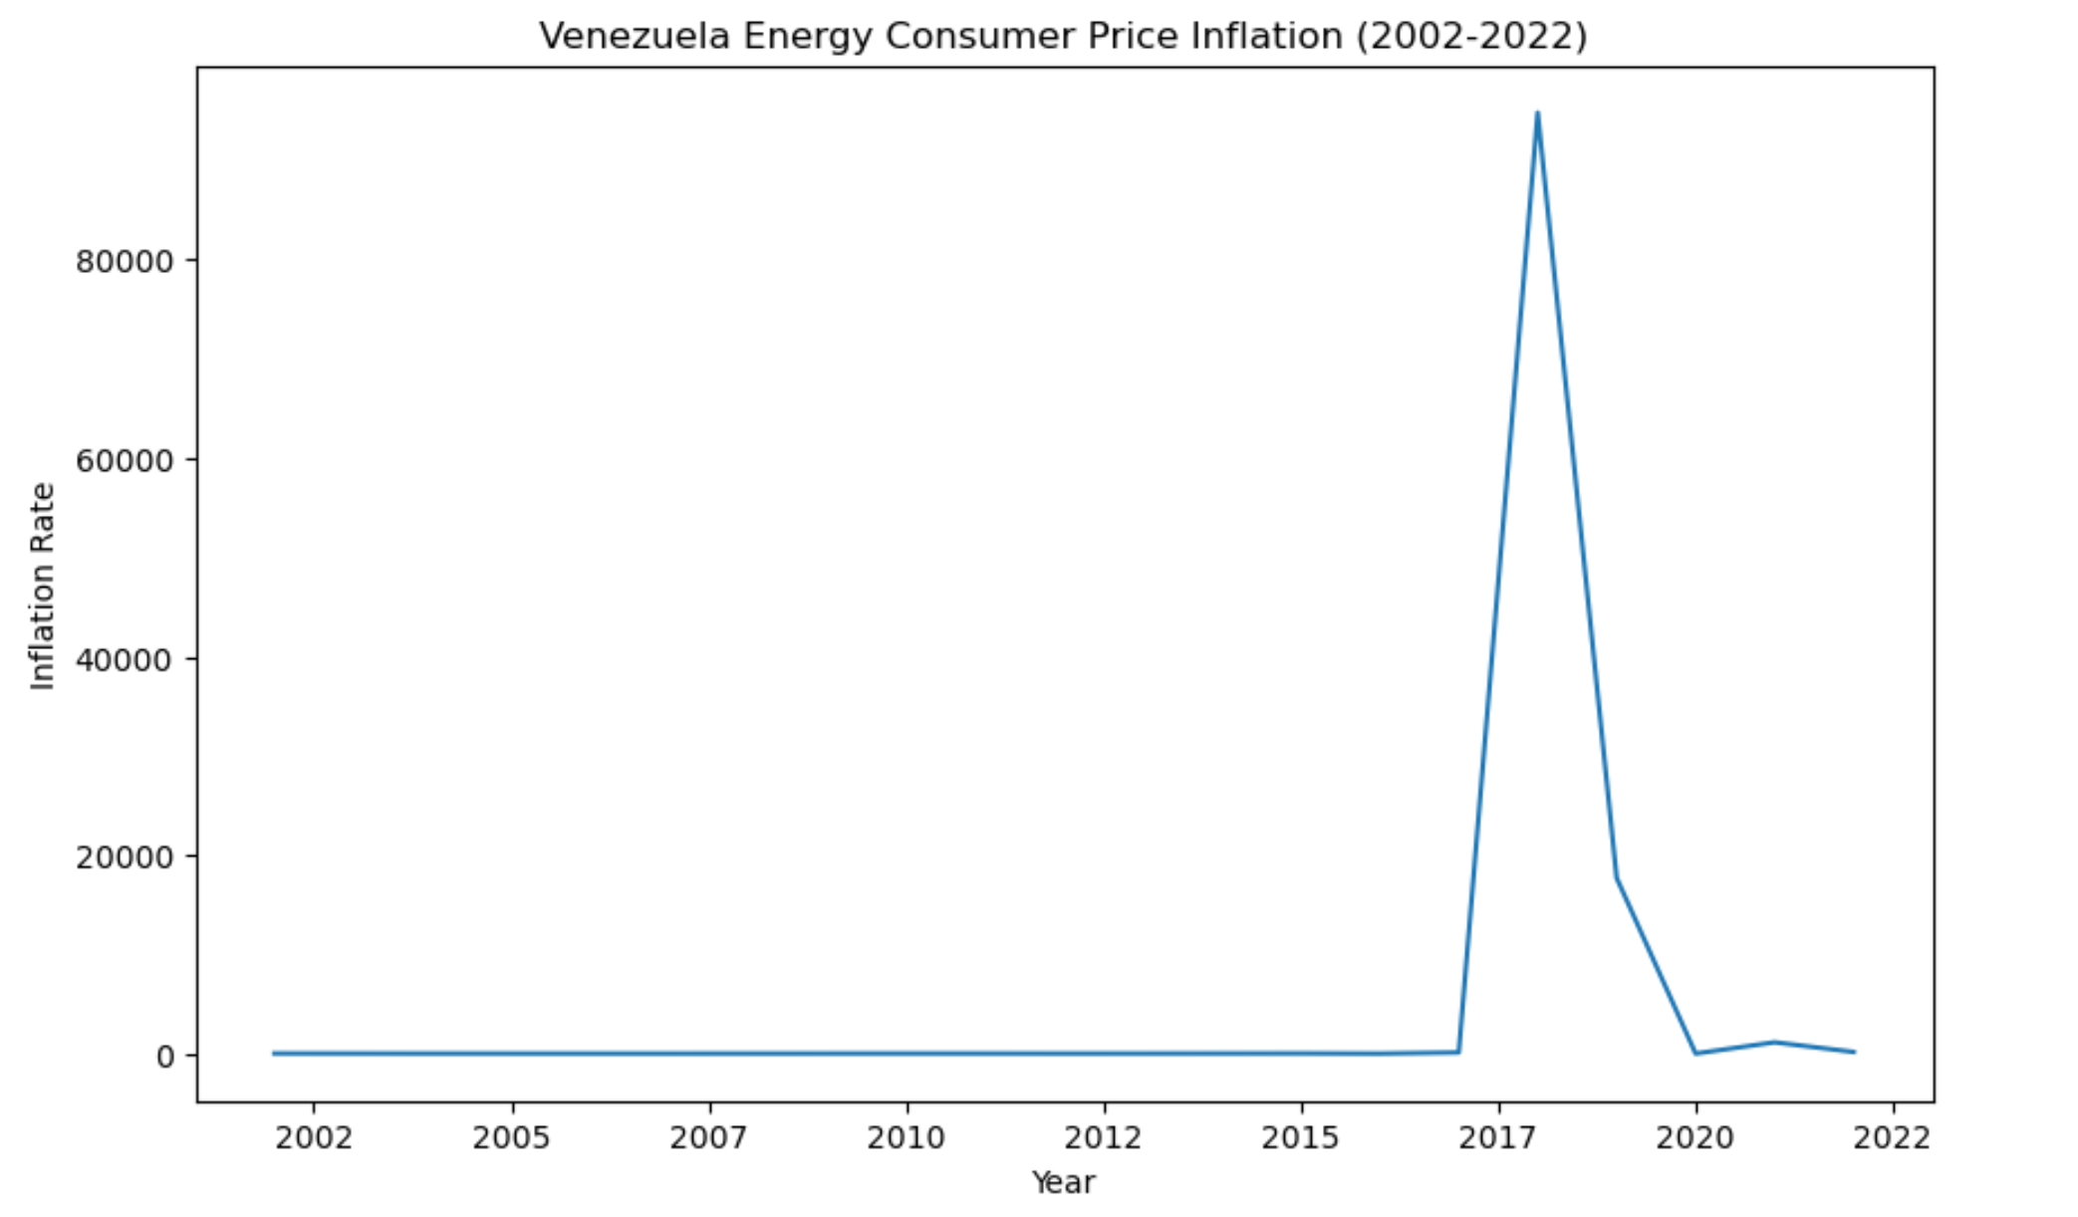
Energy Consumer Price Inflation -Country with Highest Inflation-

Slide 8
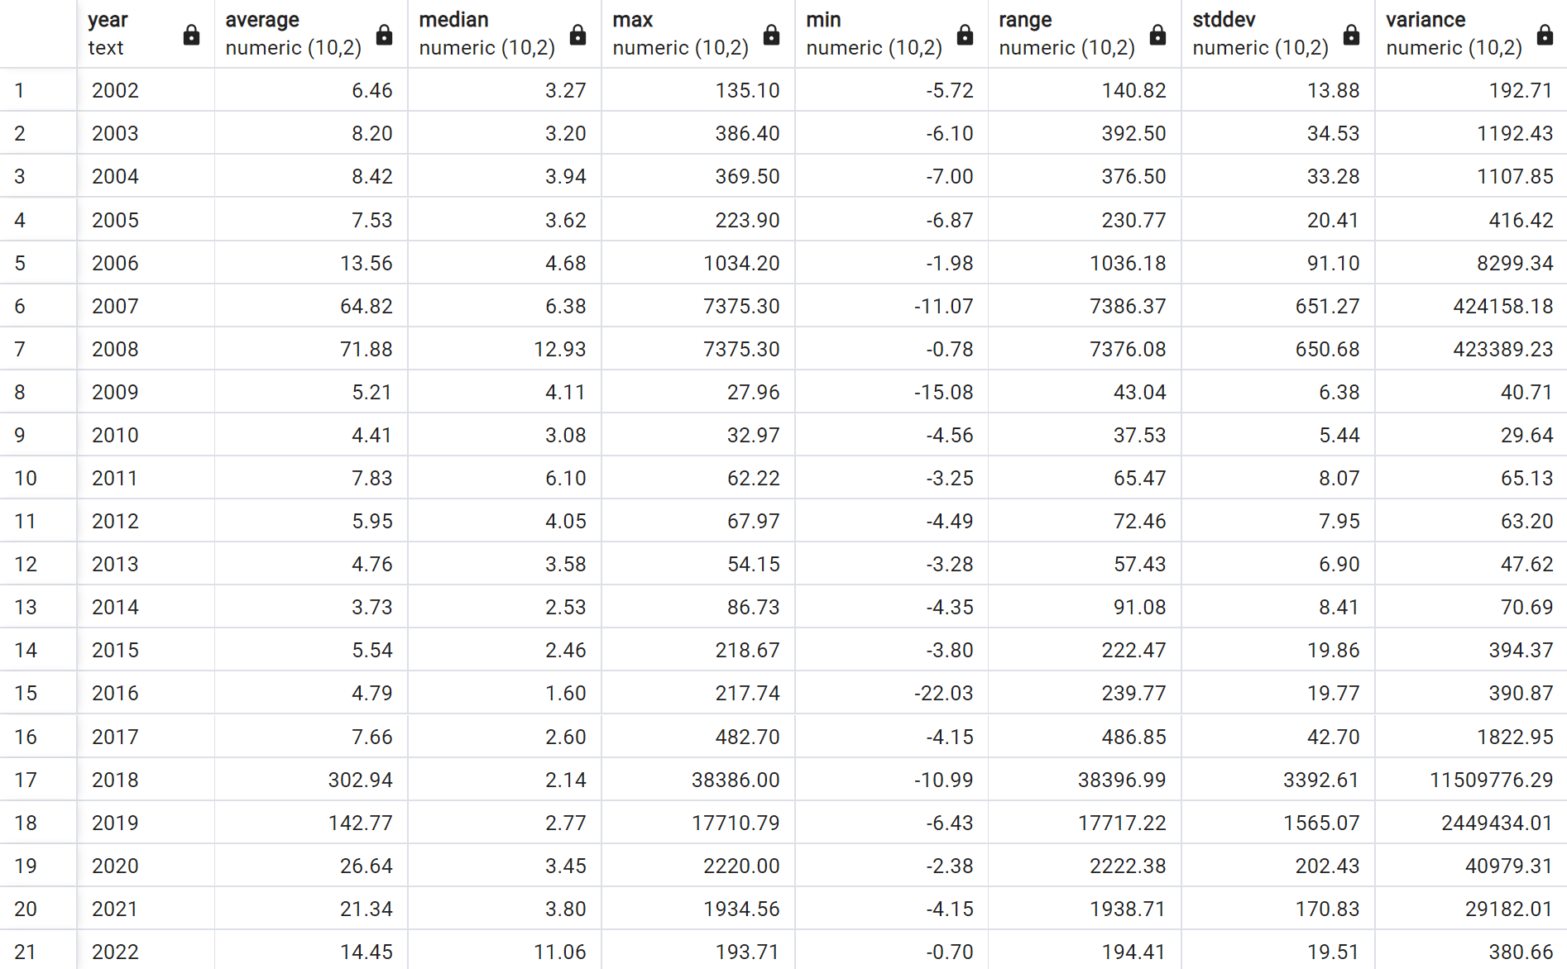
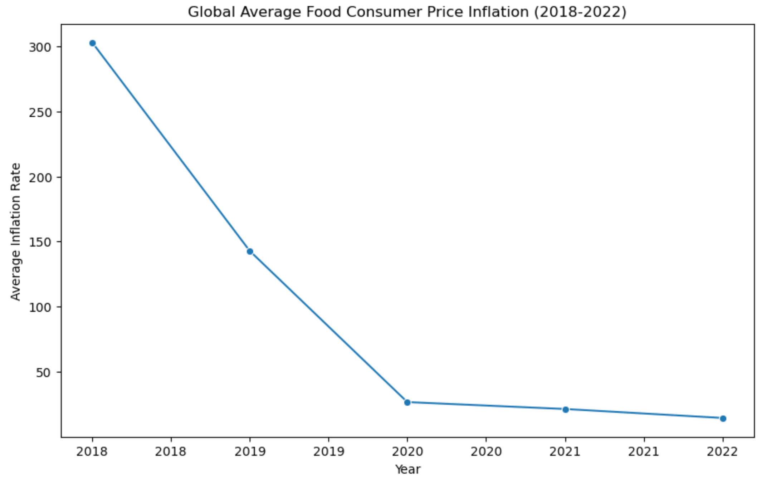
Food Consumer Price Inflation -Inflation Rate for Food Cost-

Slide 9
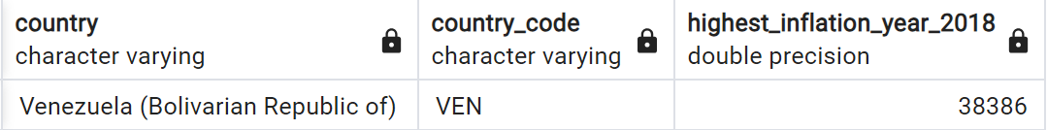
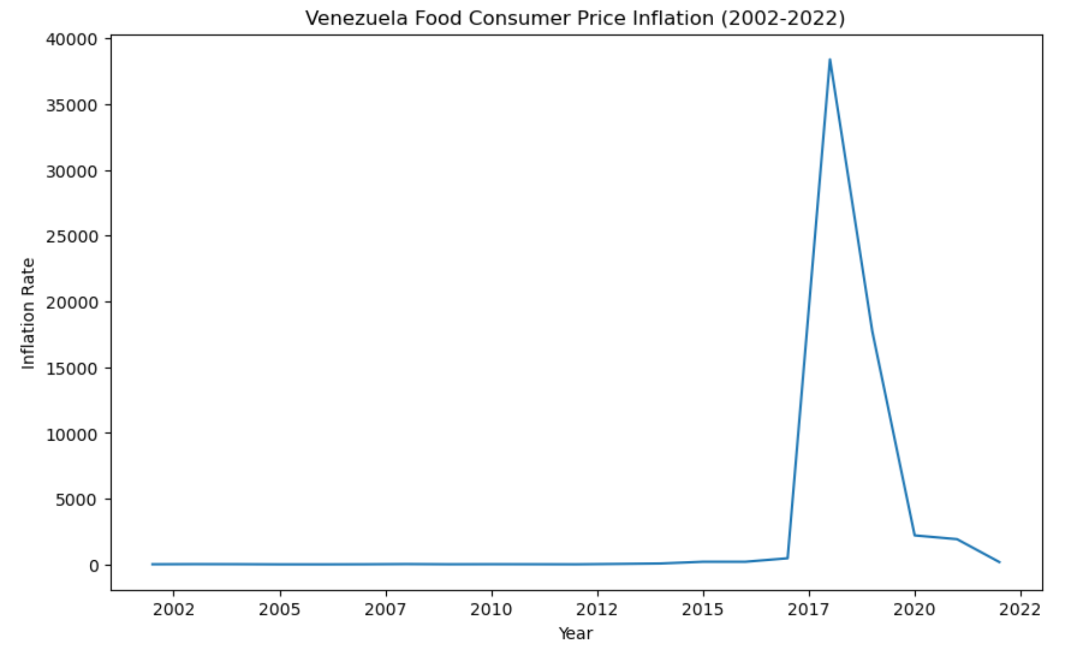
Food Consumer Price Inflation -Country with Highest Inflation-

Slide 10
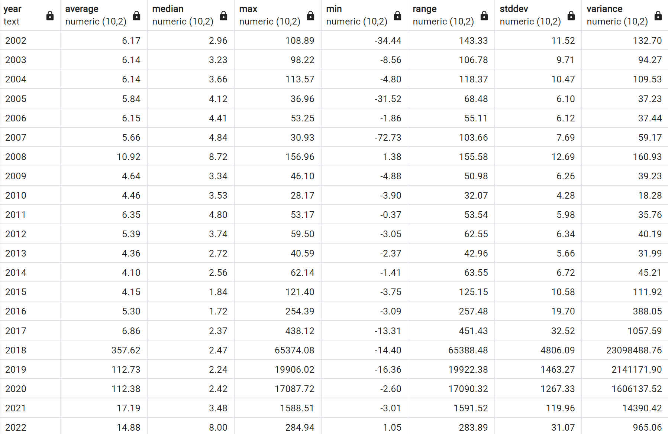
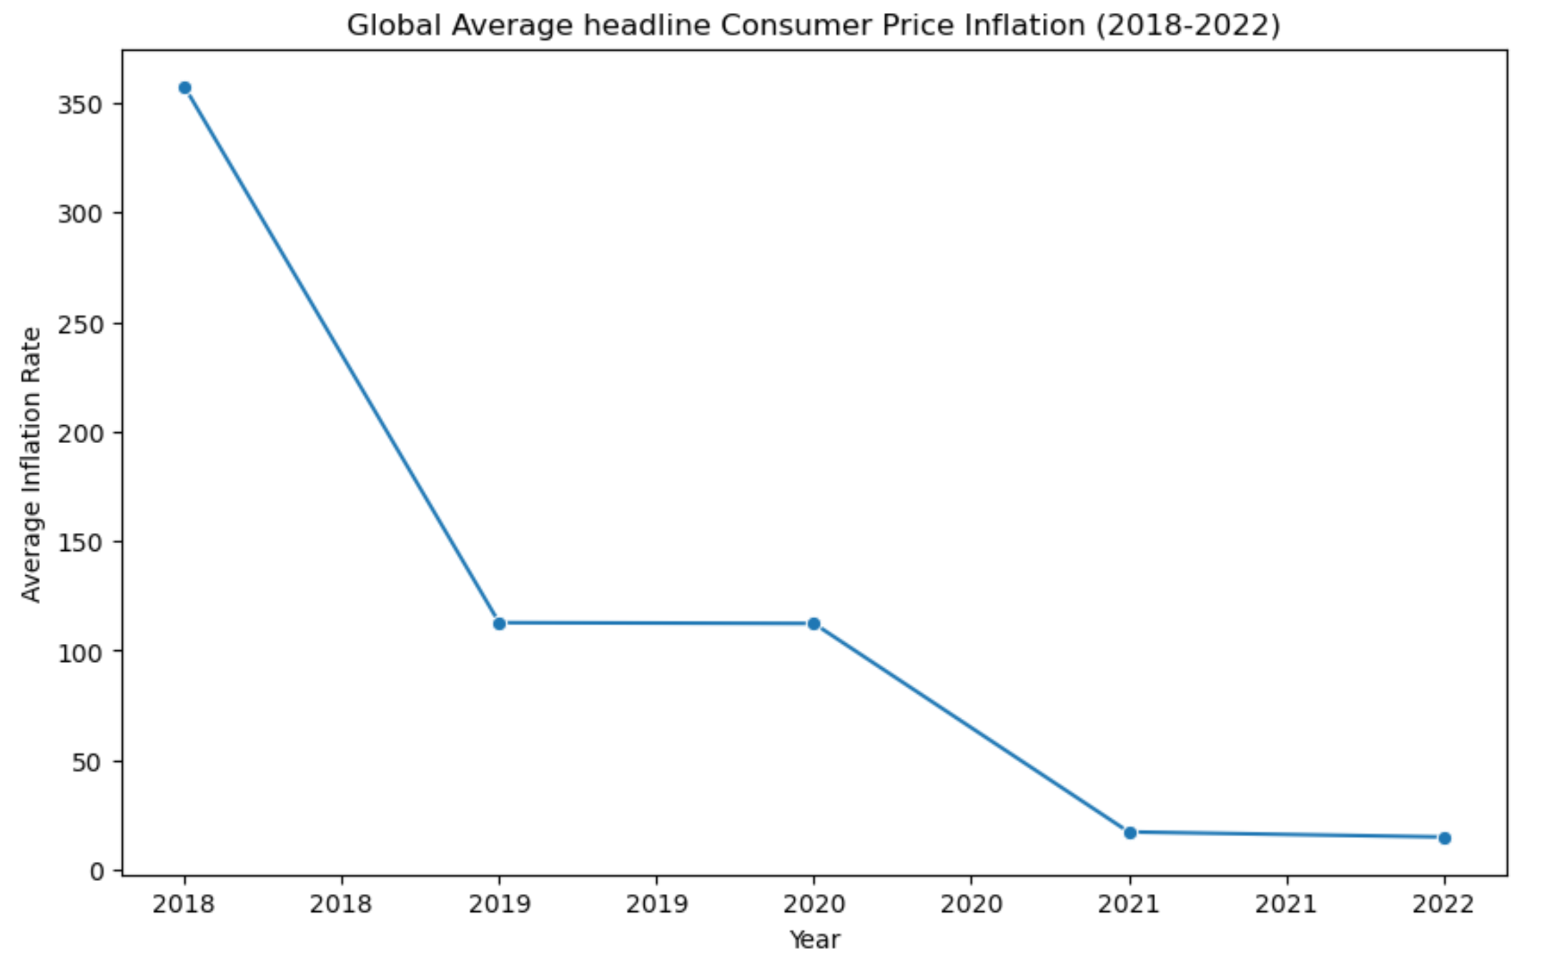
Headline Consumer Price Inflation -Overall Inflation Rate by Consumer Price Index-

Slide 11
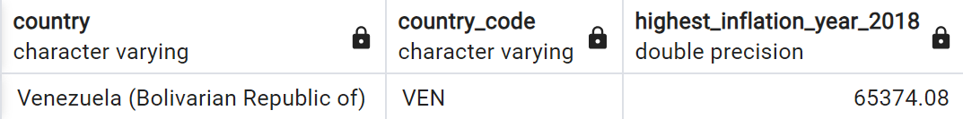
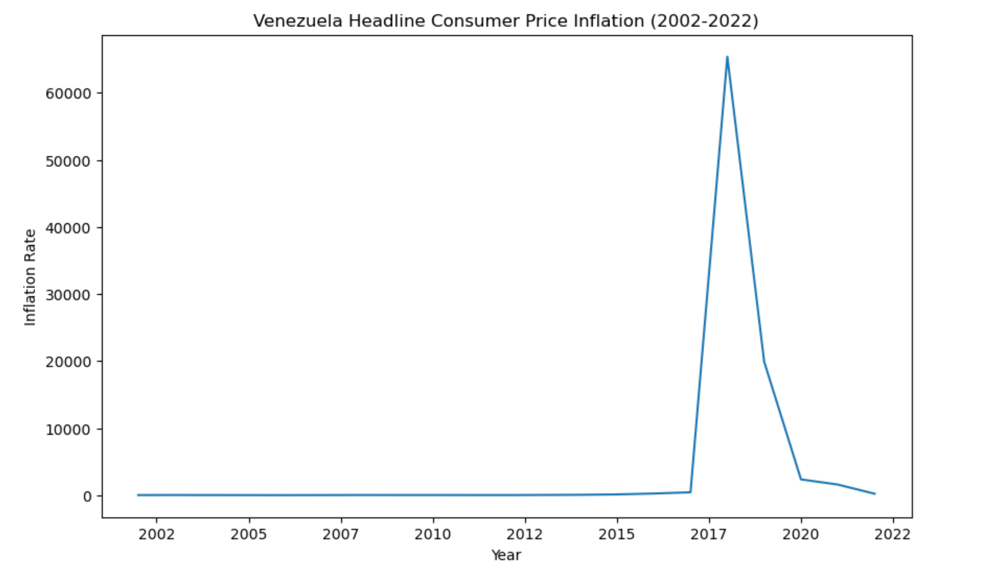
Headline Consumer Price Inflation -Country with Highest Inflation-

Slide 12
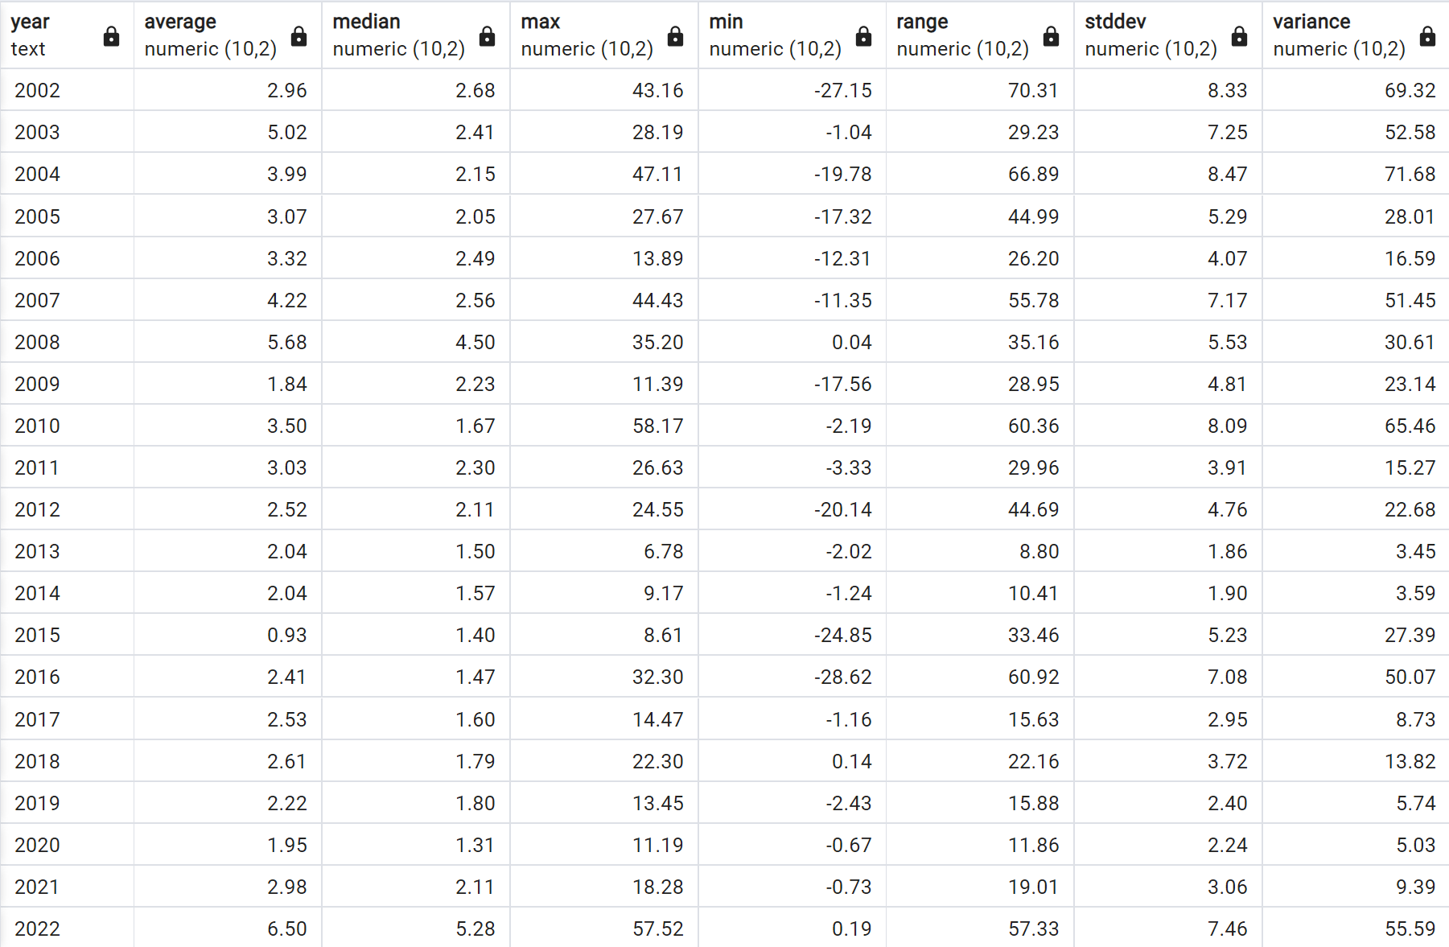
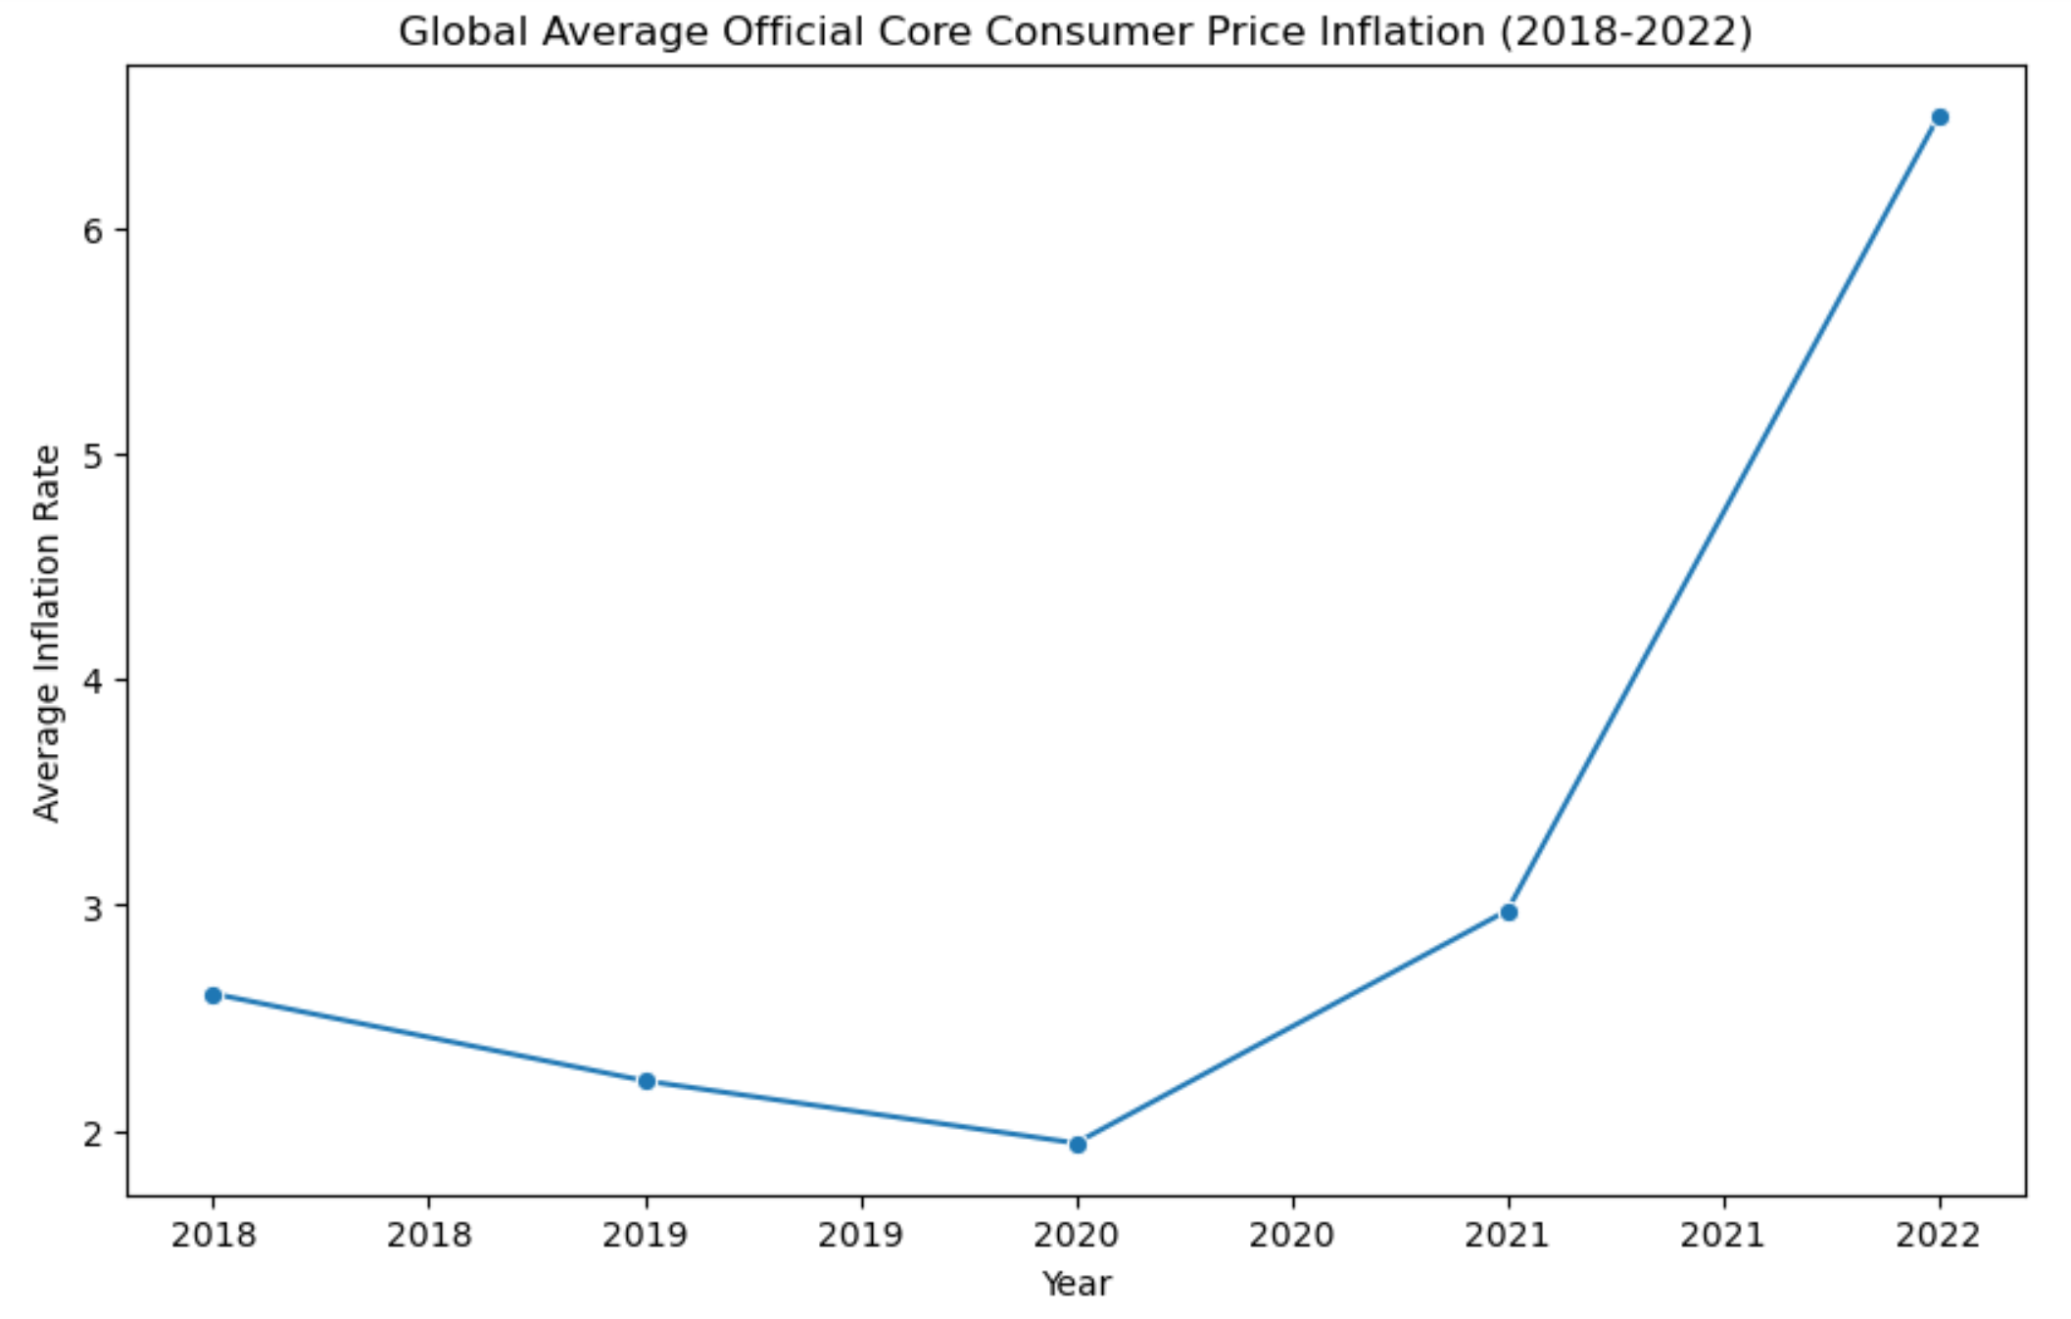
Official Core Consumer Price Inflation -Inflation Rate for Goods and Services-

Slide 13

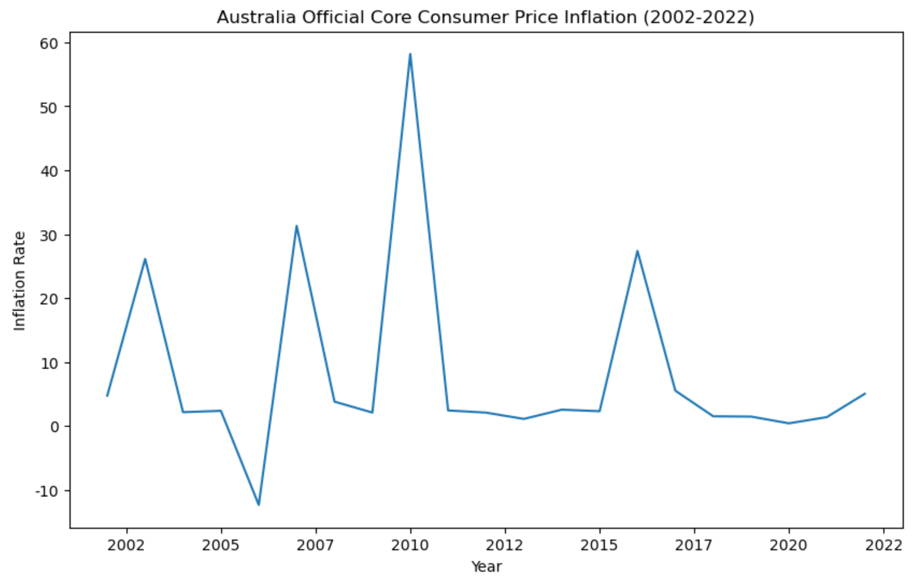
Official Core Consumer Price Inflation -Country with Highest Inflation-

Slide 14
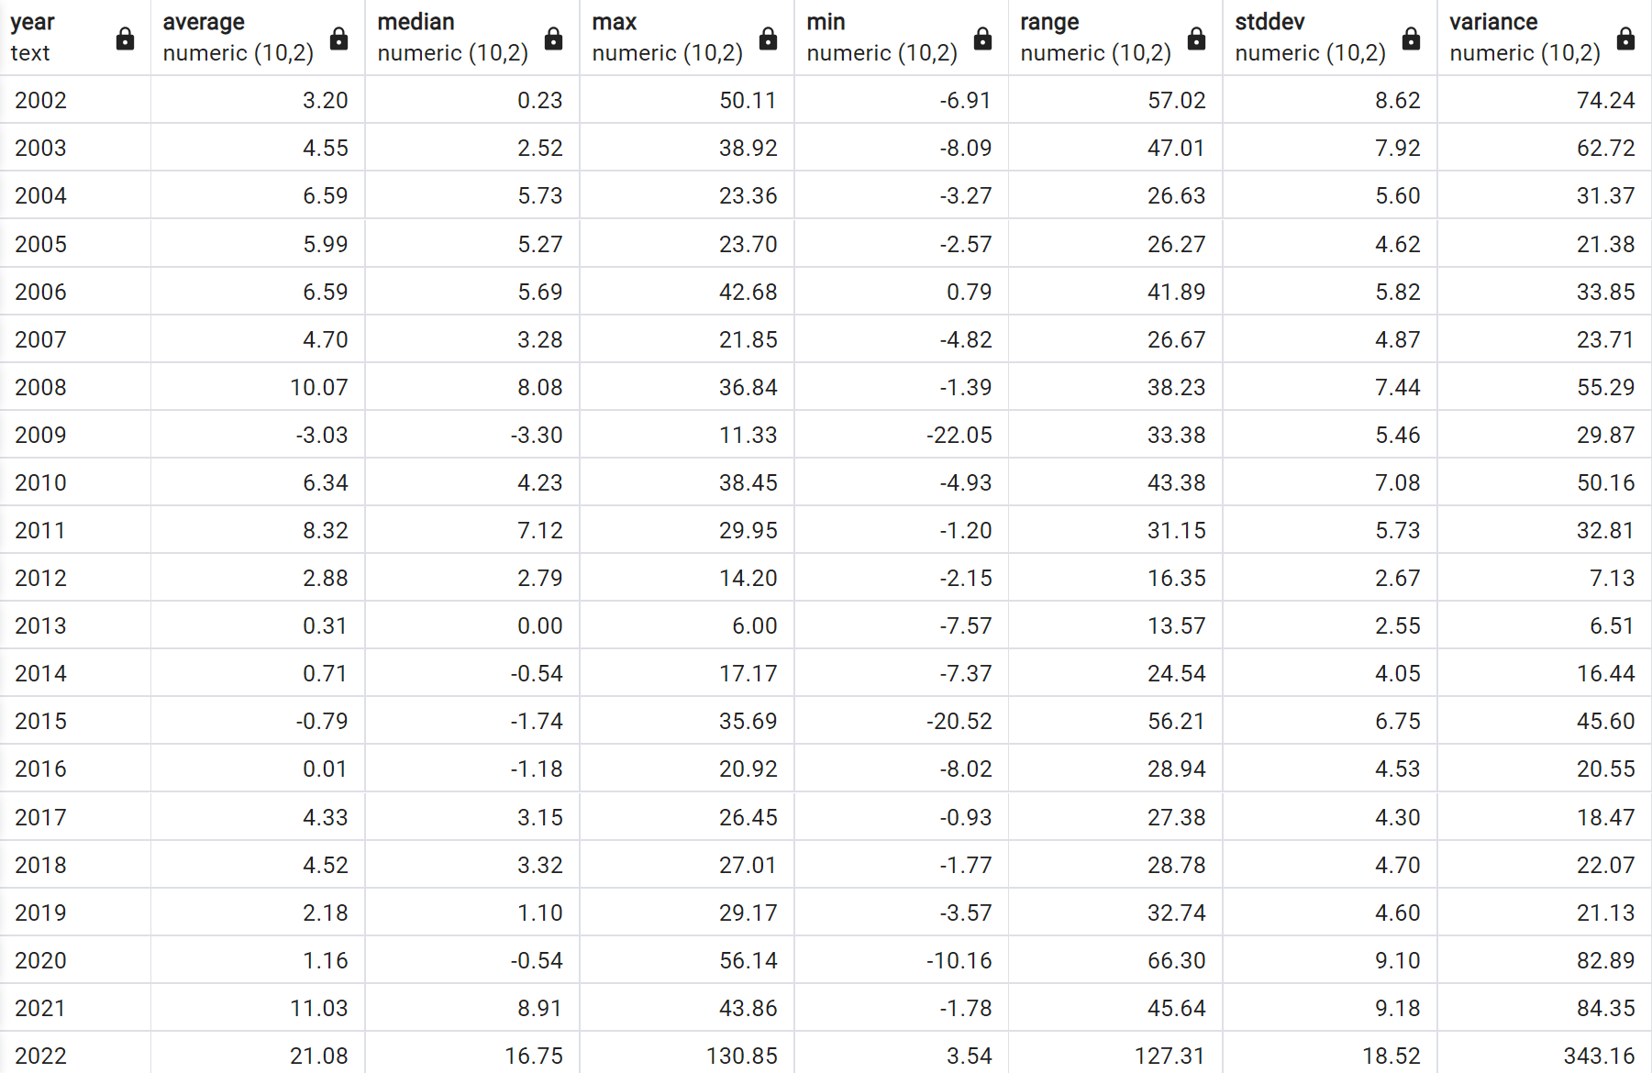
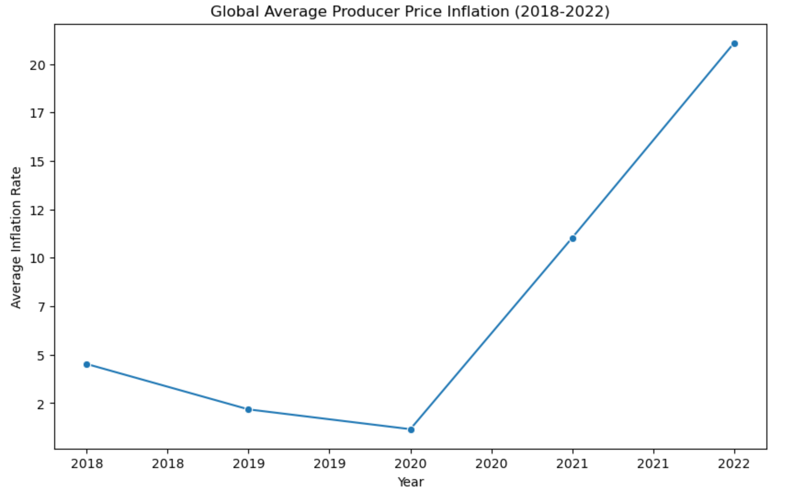
Producer Price Inflation -Inflation Rate for Selling Prices-

Slide 15
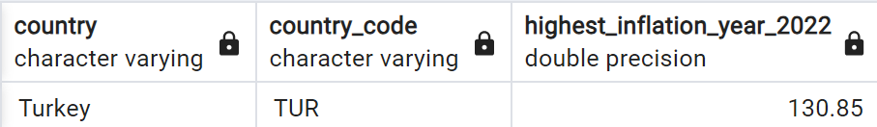
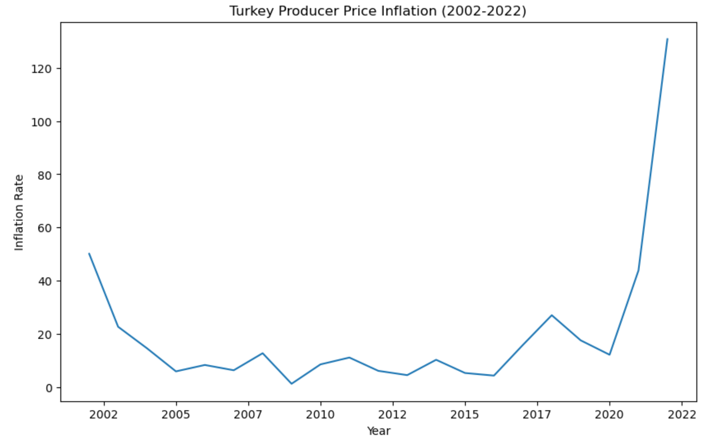
Producer Price Inflation -Country with Highest Inflation-

Slide 16
DESCRIPTIVE STATISTICS
COVID-19
FROM 2019 TO 2022

Slide 17
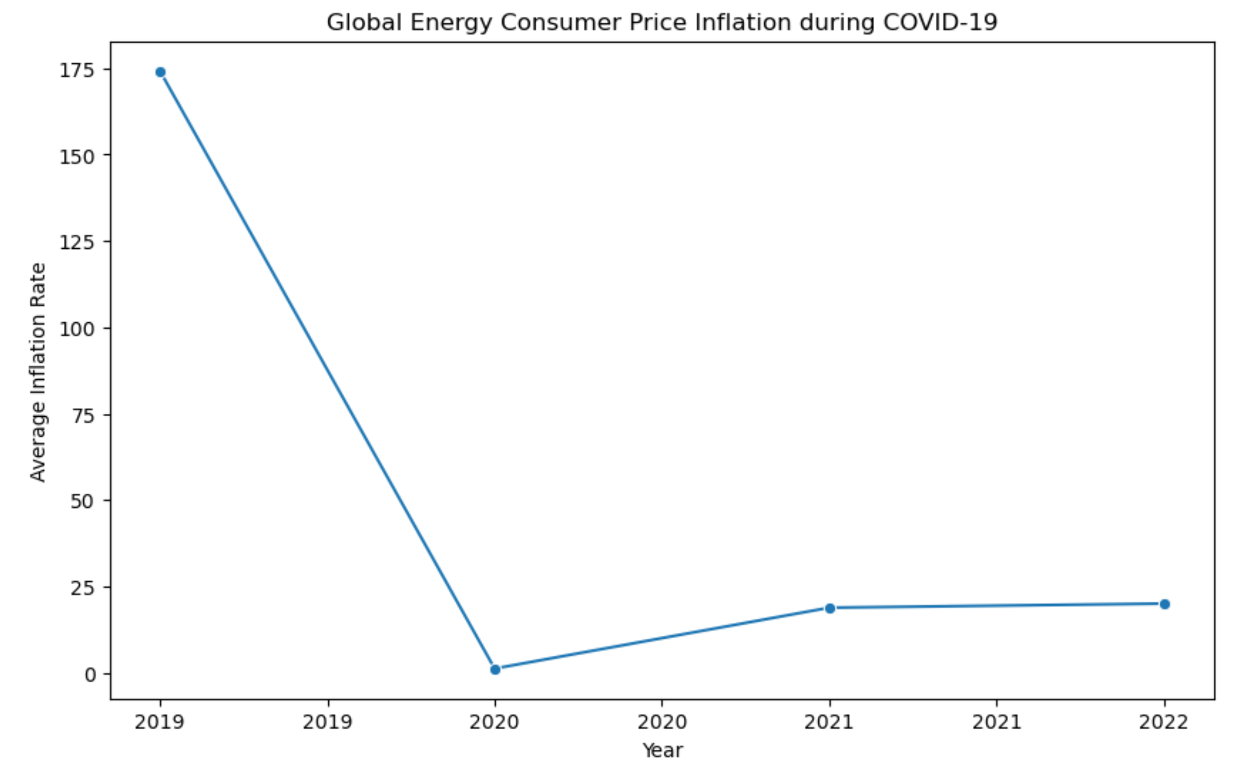
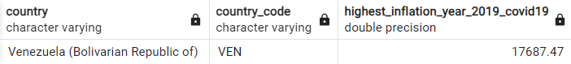
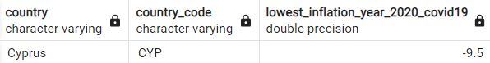
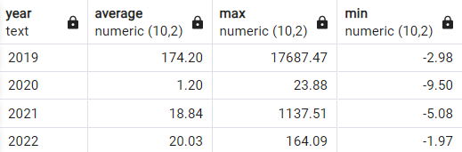
Average Energy Consumer Price Inflation during COVID-19 (2019-2022)

Slide 18
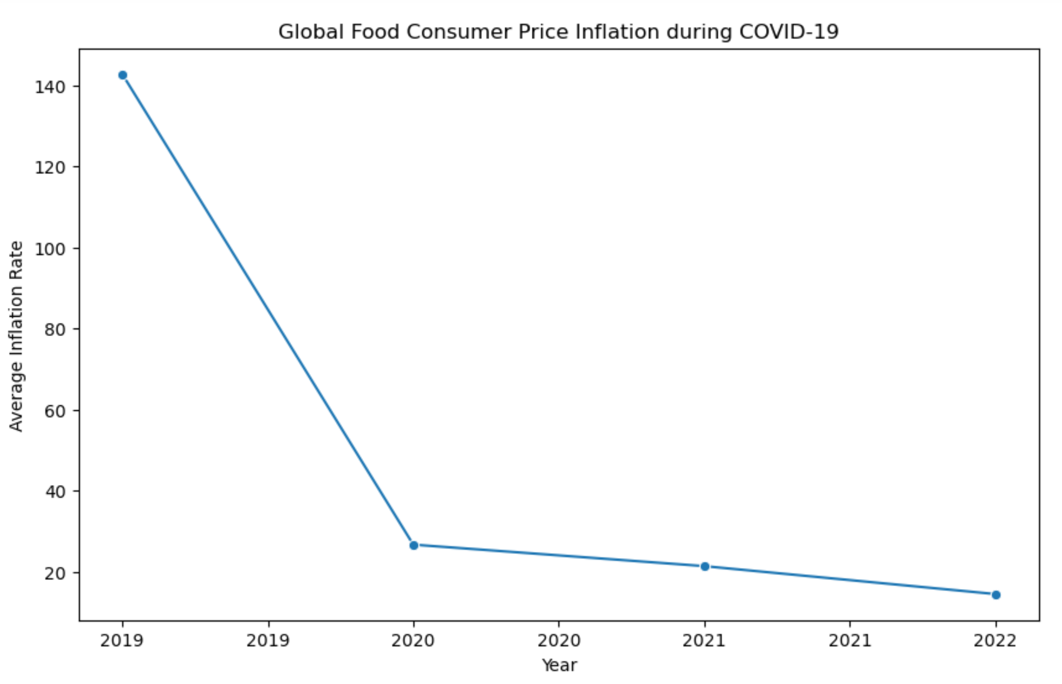
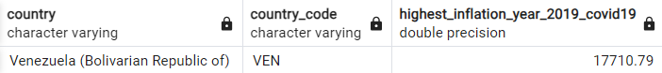

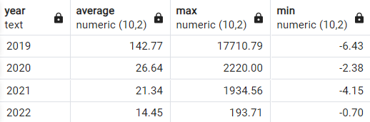
Average Food Consumer Price Inflation during COVID-19 (2019-2022)

Slide 19
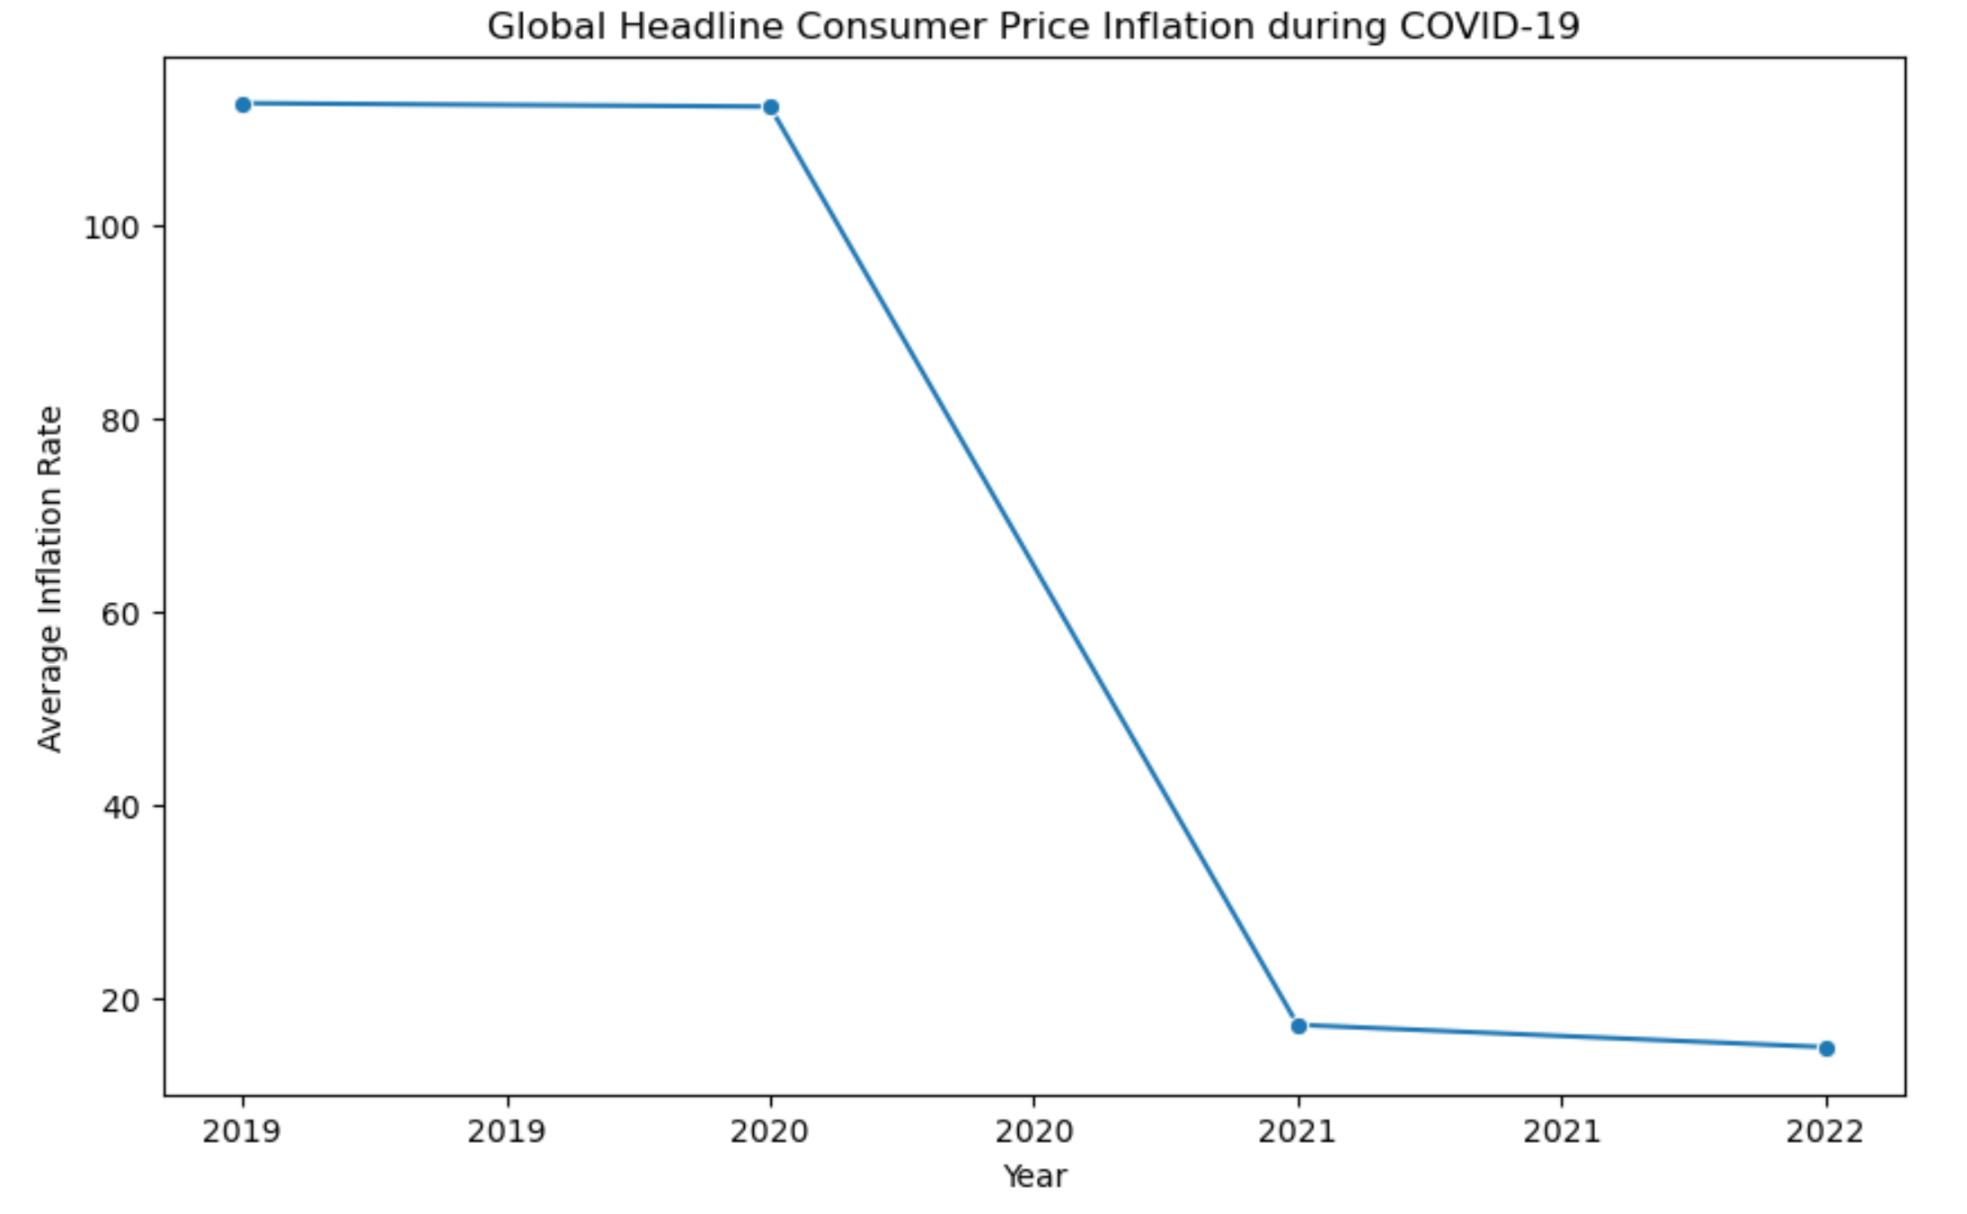
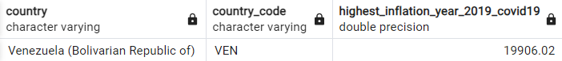
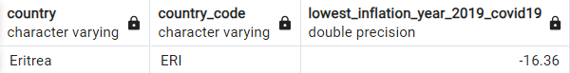
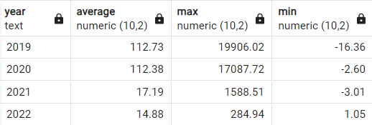
Average Headline Consumer Price Inflation during COVID-19 (2019-2022)

Slide 20
Which country saw the highest inflation increase during COVID-19?
A. Turkey
B. Argentina
C. Venezuela
D. Zimbabwe

Slide 21
Which country saw the highest inflation increase during COVID-19?
A. Turkey
B. Argentina
C. Venezuela
D. Zimbabwe

Slide 22

PREDICTIVE STATISTICS
on Venezuela

Slide 23
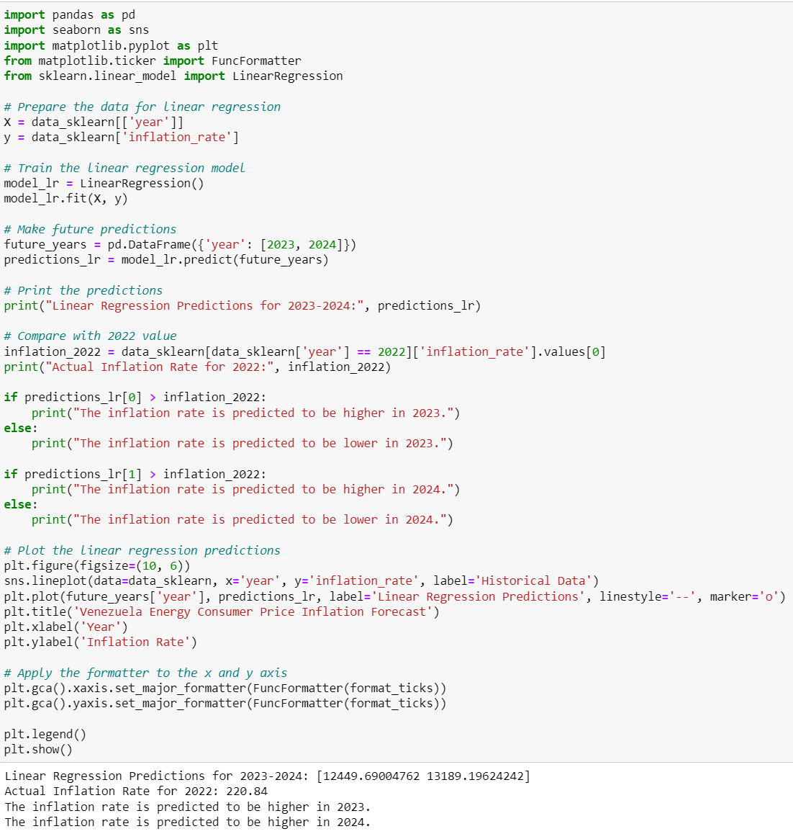
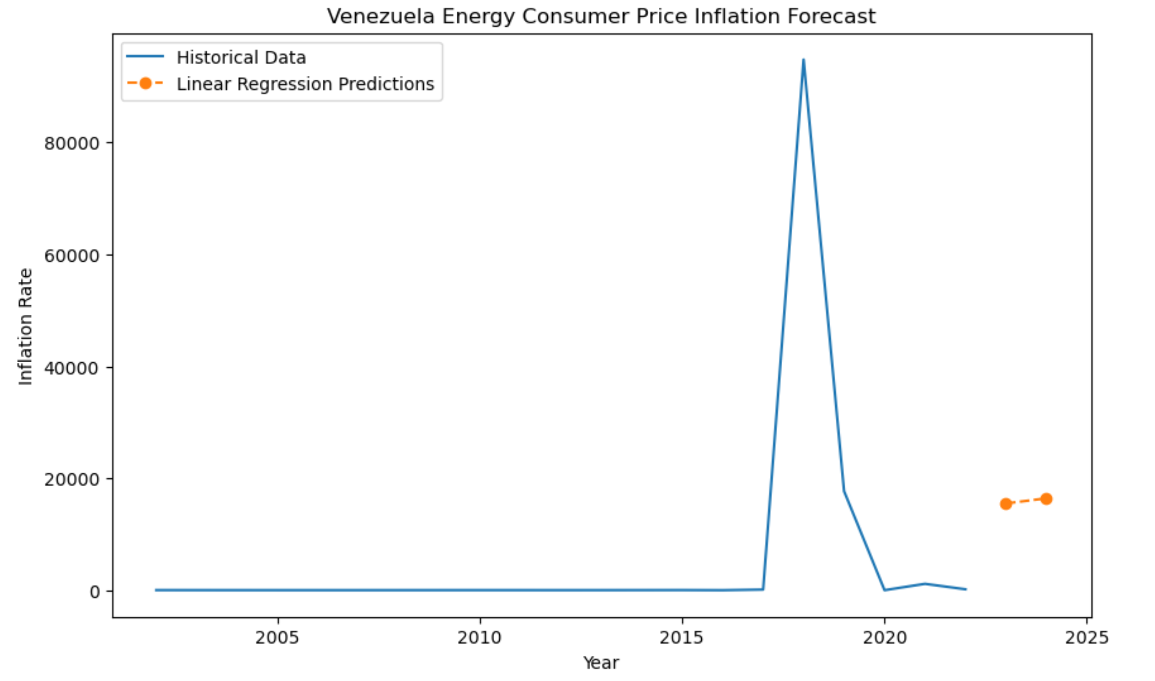
Energy Consumer Price Inflation -Venezuela-

Slide 24
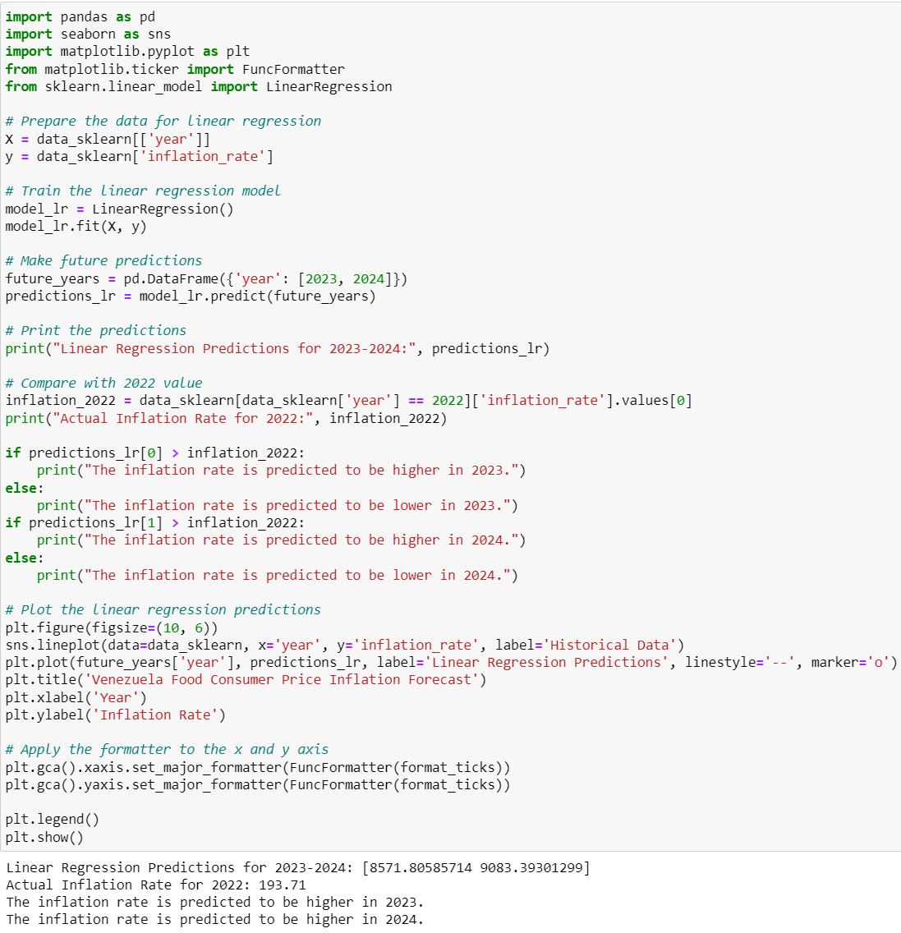
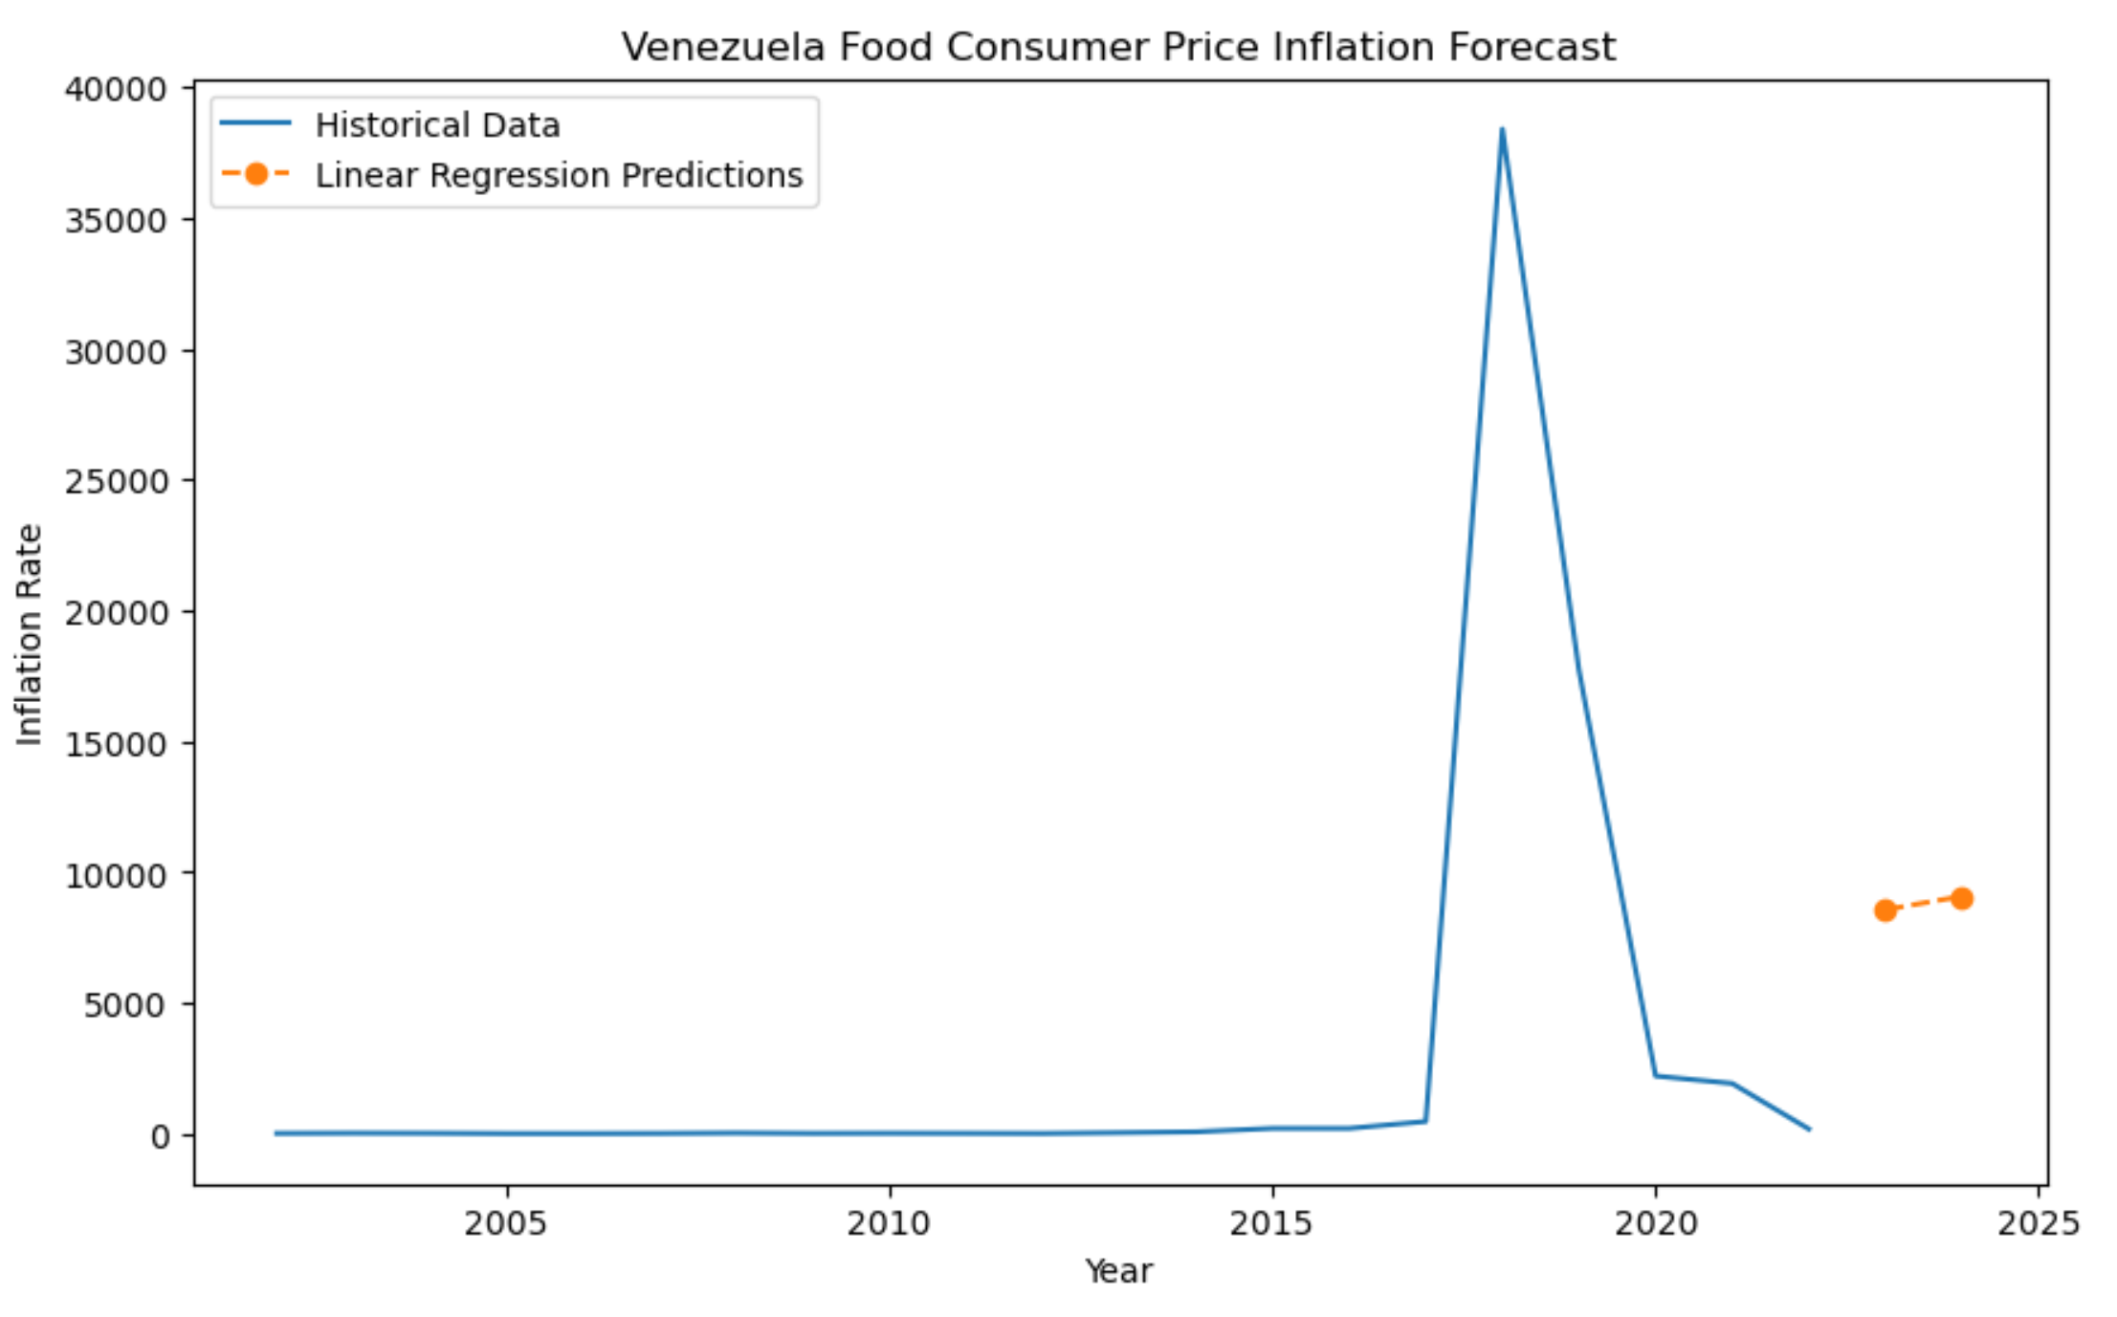
Food Consumer Price Inflation -Venezuela-

Slide 25
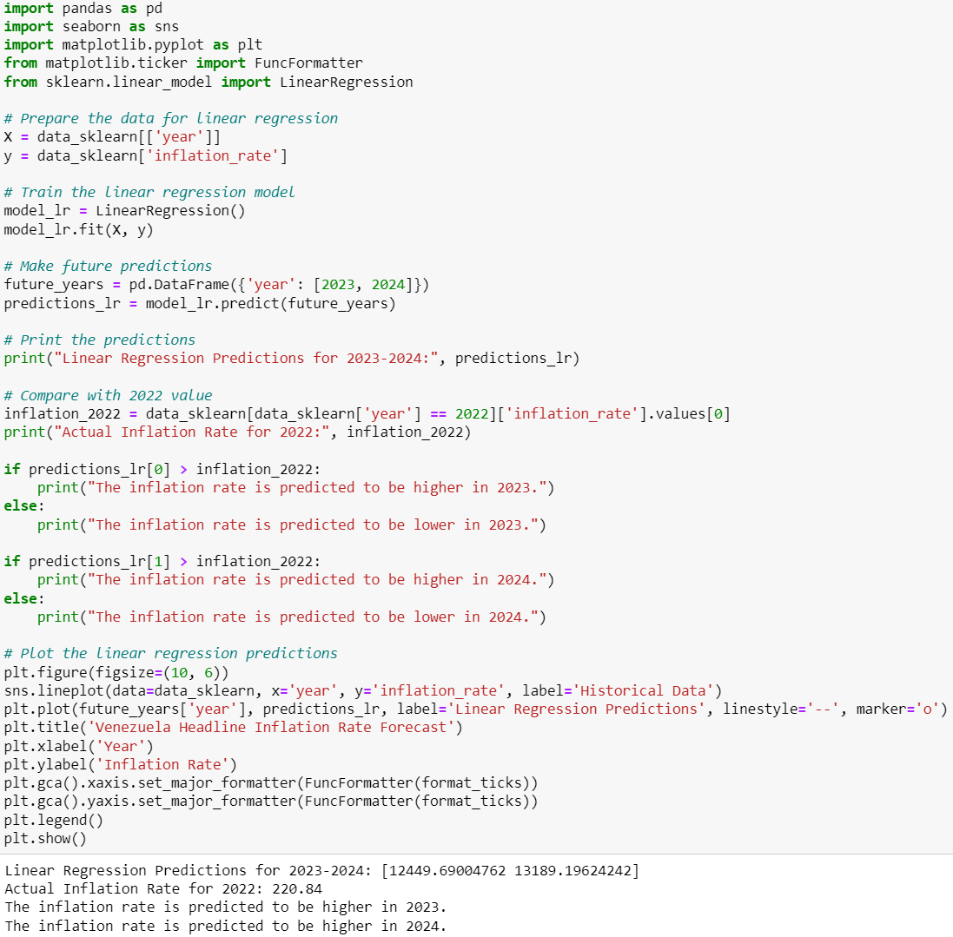
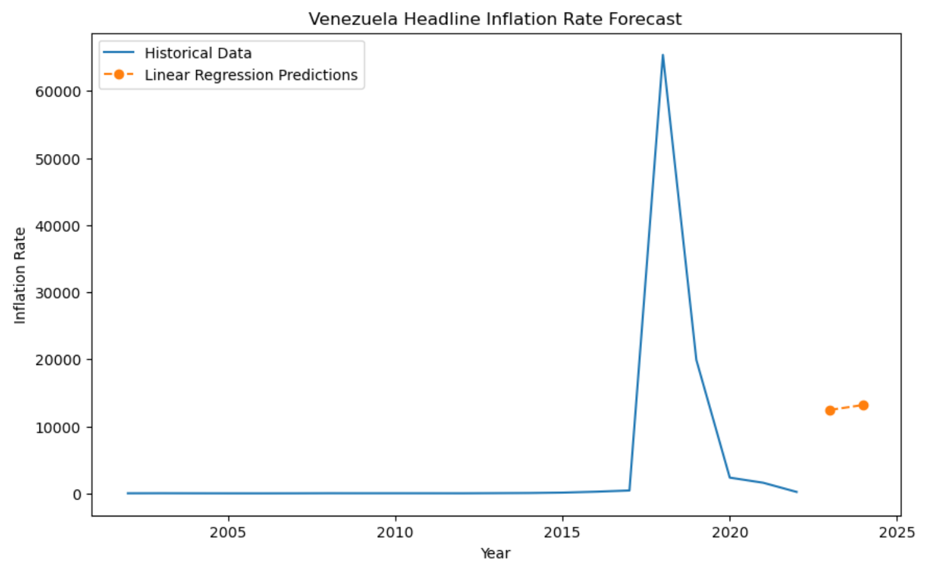
Headline Consumer Price Inflation -Venezuela-

Slide 26

Conclusion
Descriptive statistics analysis from 2002 to 2022 on global inflation:
In 2018, Venezuela had the highest inflation rate for energy, food, and headline consumer price inflation.
In 2010, Australia had the highest rate for official core consumer price inflation.
In 2022, Turkey had the highest rate for producer price inflation.
Venezuela's inflation rate data was not complete and therefore not included for the official core consumer and producer price inflation analyses.
Descriptive statistics analysis from 2019 to 2022 during COVID-19:
In 2019, Venezuela had the highest inflation rate for energy, food, and headline consumer price inflation.
Predictive statistics analysis for Venezuela’s inflation from 2023 to 2024 is estimated to increase.

Slide 27
Questions
Thank you

